Slide 1
Neural Network Game
Presented by:
Yaswanth - 2003287

Slide 2
Data Pre-processing
Read the data using pandas
Check for null values
Drop Duplicates
Give column names
Normalize the data
Split the data into train(80%) and test (20%)
Convert the data into array/matrix

Slide 3
Neural Network
Create Sigmoid function and it’s derivative(taking lambda value as 0.01)
Initialize weights and biases to random values.
Calculate Feed forward (dot product of inputs and hidden weights),(dot product of activation outputs and output weights)
Backward Propagation :
Calculate Error (2*e)
Calculate Local Gradient(delta)
Calculate change/derivative of weights
Updating the weights and biases

Slide 4

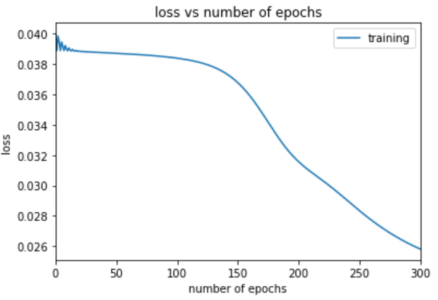
Hyper Parameters
Calculate Loss/ Cost (RMSE) (Got loss reduced to 0.026).
Given 8 neurons in hidden layer (tried 5 to 10 neurons).
Given 500 epochs (tried 100 to 10,000).
Given alpha and lambda as 0.1 (tried 0.1 to 0.01).
Given Learning rate as 0.01(tried 01 to 0.01).
Finally, got weights and biases.
Gave the weights and biases in Neural Net.py, calculated forward propagation and ran the game.

